Slide 1
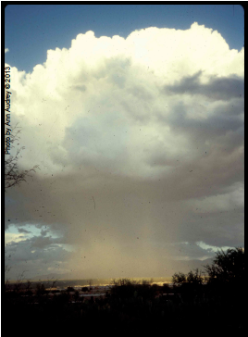




[INSERT NAME OF YOUR COMMUNITY HERE]
Assessment of
Rainwater and Stormwater Harvesting Potential
Presentation made possible through a project funded by U.S. Bureau of Reclamation
Landscape Conservation Cooperative WaterSMART Program
Project conducted by University of Arizona Water Resources Research Center, with input from Technical Advisory Committee, Water Harvesting and Landscape Consultants, and Regional Water Managers

Slide 2
Typical water resource challenges in the Southwest US
Potable demand exceeds supply
Insufficient capacity to meet peak demand
Negative environmental impacts
Climate change impacting supply & demand
Increasing urban heat island effect
Increasing stormwater volume
Stormwater quality issues
Meet multiple challenges with multi-function solutions

Slide 3
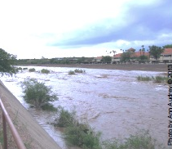
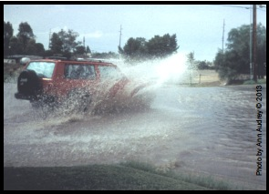
(YOUR most important) water resource challenges
Increasing hardscape results in more street flooding
Replace these pictures and captions with additional challenges you face in YOUR area. Duplicate this template slide as needed to insert additional local slides
Flashy high flood peaks in rivers and streams

Slide 4
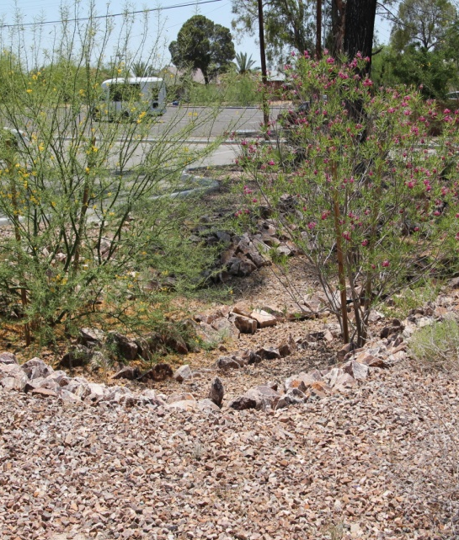
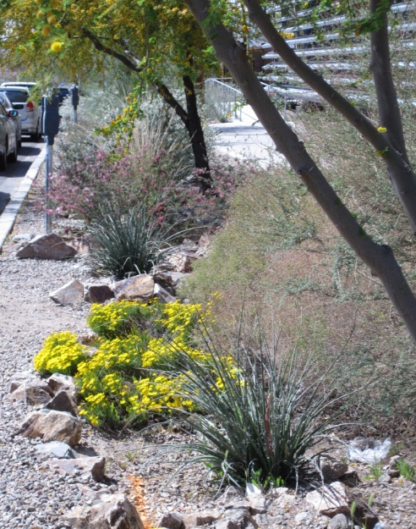
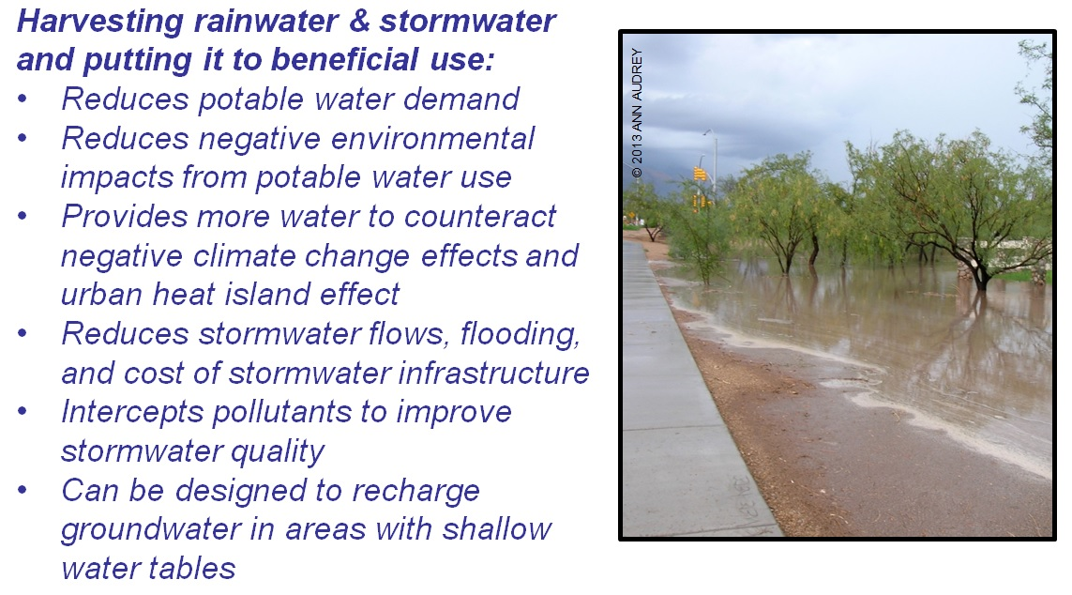
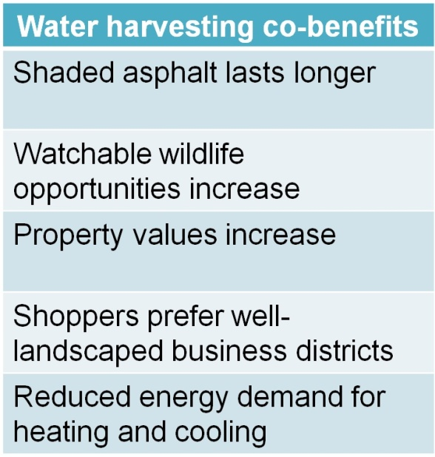
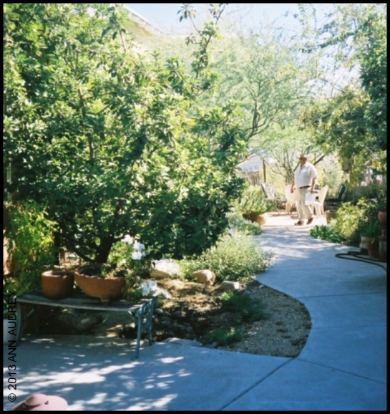
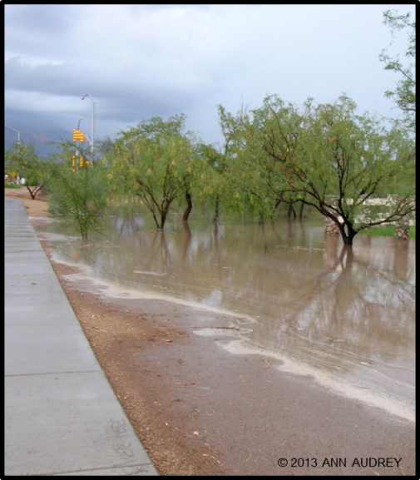
Typical Water harvesting benefits in the US Southwest
Typical Water Harvesting Benefits in the Southwest US

Slide 5
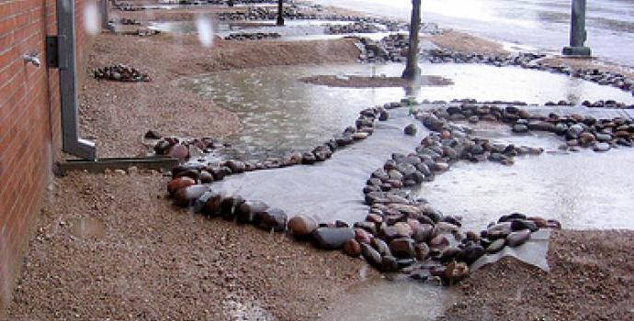
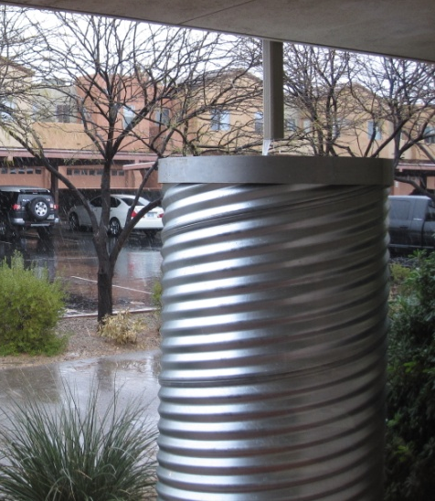
Water harvesting definitions
Water harvesting is a strategy to intercept rainwater (rain falling from the sky) and stormwater (rain that has hit surfaces) and put the water to beneficial uses including supporting trees and vegetation and meeting other needs.
Passive water harvesting is the collection of water from surfaces (roofs, parking lots, roads, natural areas) for infiltration directly at the land surface or subsurface.
Active water harvesting captures and retains rainwater in tanks/cisterns for beneficial use at a later time. Above ground tanks deliver water via gravity and below ground tanks require pumps to deliver water.

Slide 6
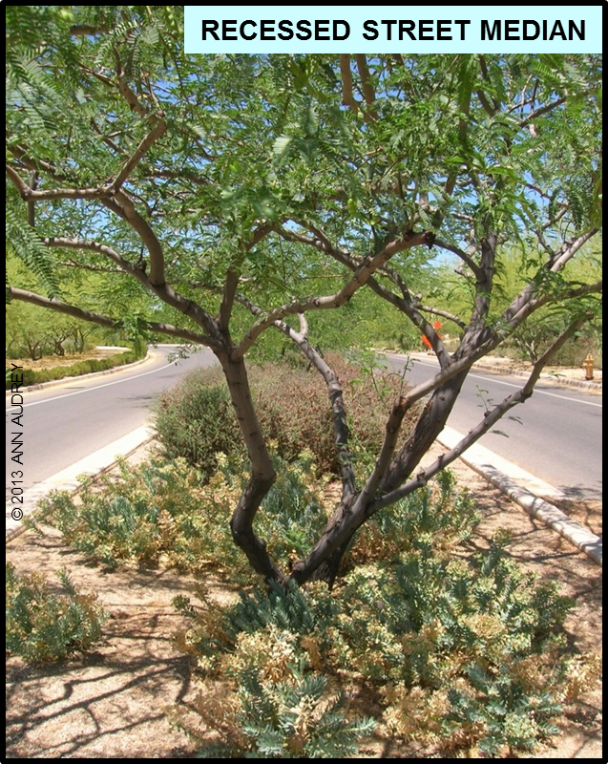
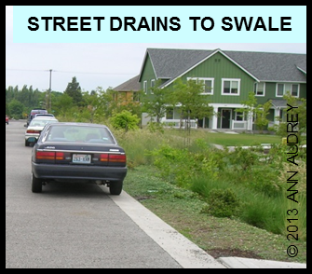
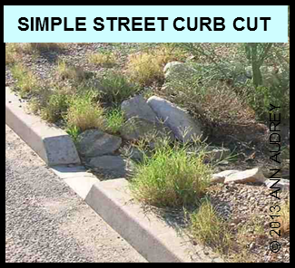
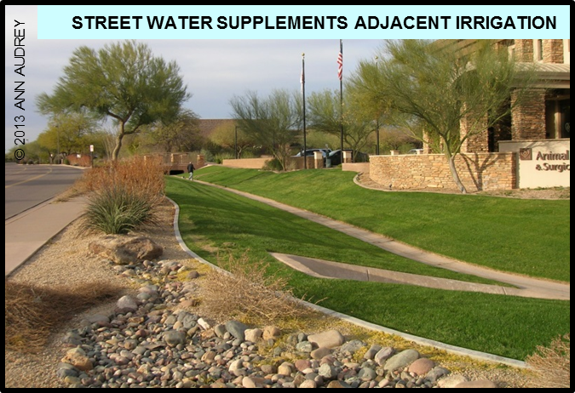
Passive techniques used in
(insert YOUR area)
Replace these pictures and captions with passive water harvesting examples in YOUR area. Duplicate this template slide as needed to insert additional local passive water harvesting slides.

Slide 7
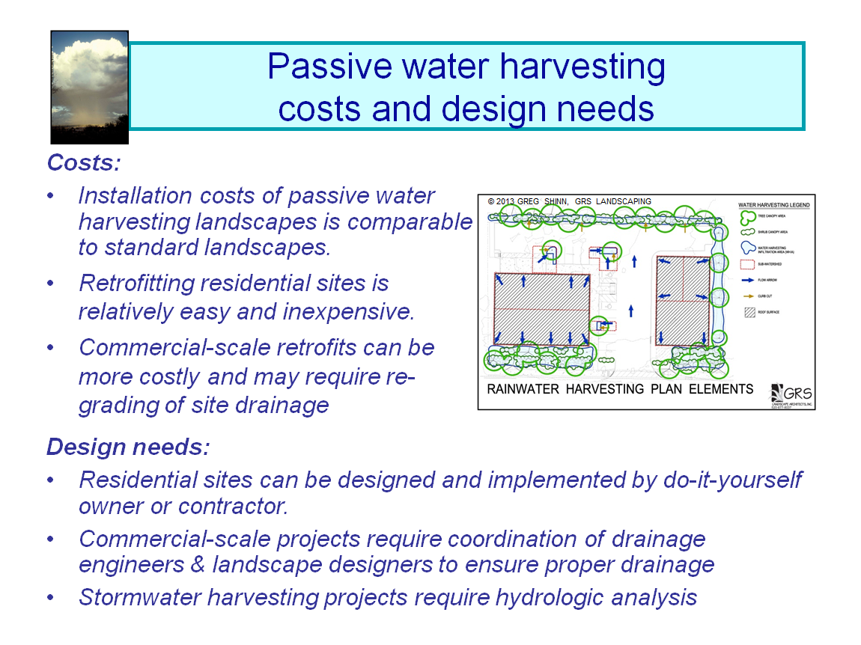

Slide 8
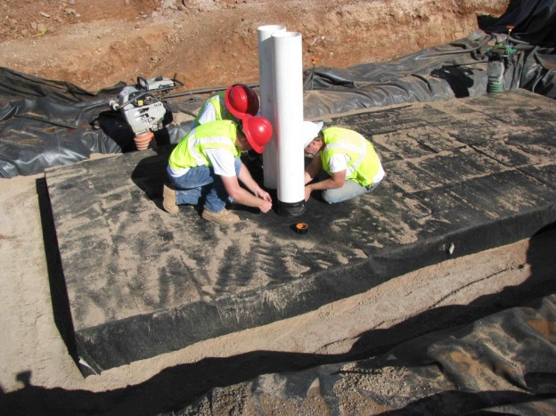
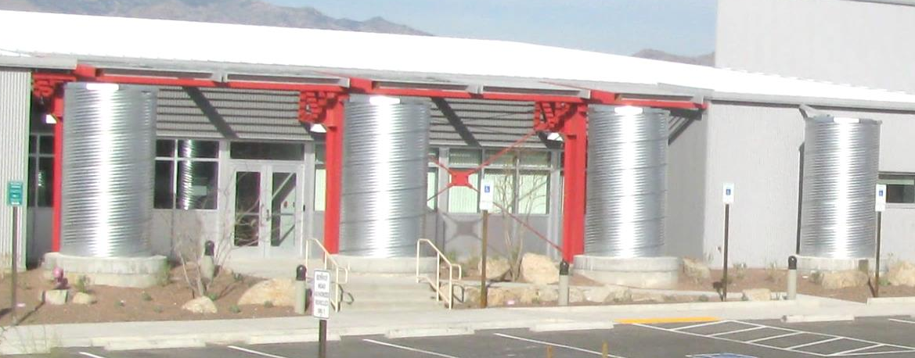
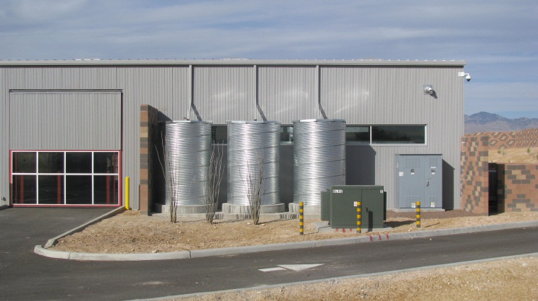
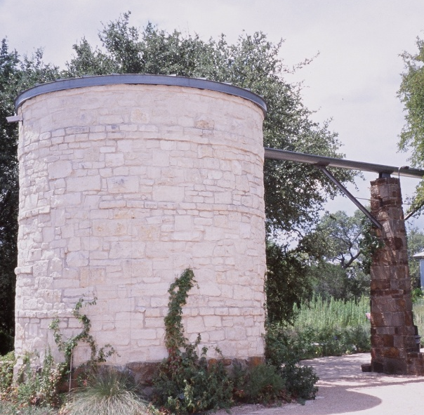
Active techniques used in
(insert YOUR area)
MODULAR CONTAINER SYSTEM
LARGE VOLUME STEEL TANKS
Replace these pictures and captions to insert active water harvesting examples in YOUR area. Duplicate this template slide as needed to insert additional local active water harvesting slides.
PHOTO BY SARG WATER SOLUTIONS
PHOTO BY SARG WATER SOLUTIONS
LARGE VOLUME STEEL TANKS
LIMESTONE-CLAD 2-STORY TANK
PHOTO BY SARG WATER SOLUTIONS
© 2013 ANN AUDREY

Slide 9
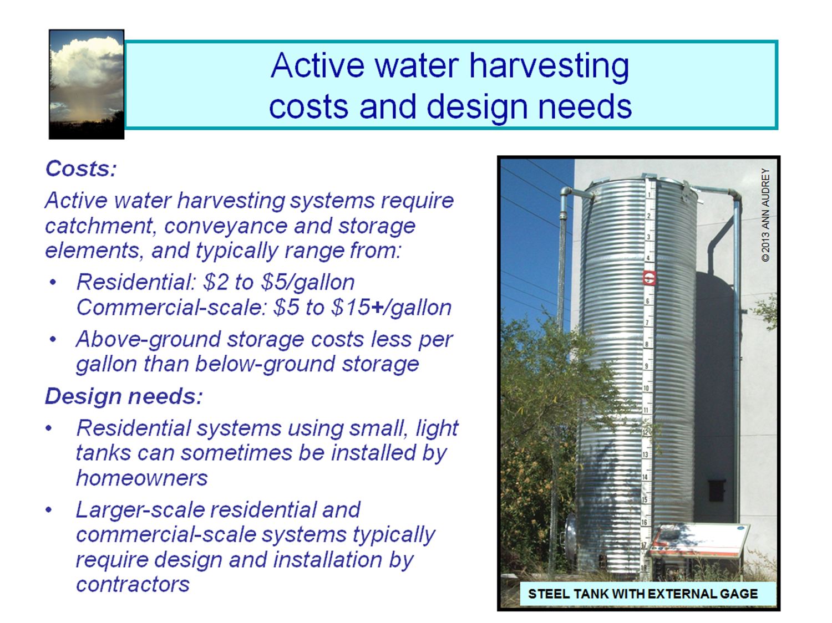

Slide 10
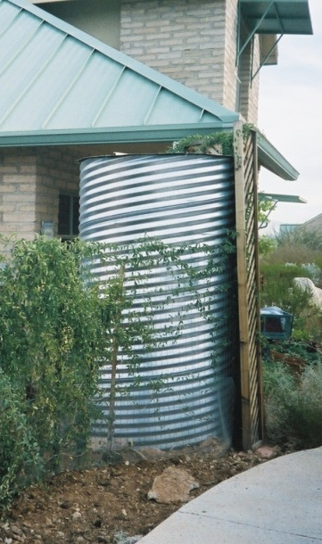
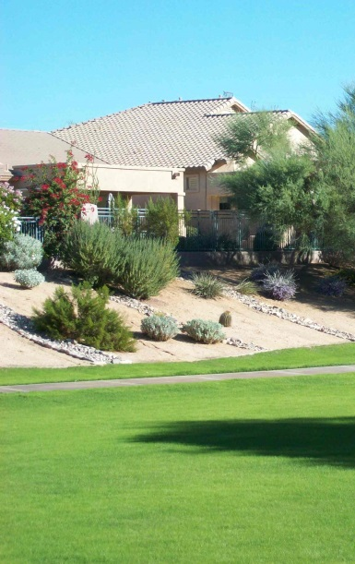
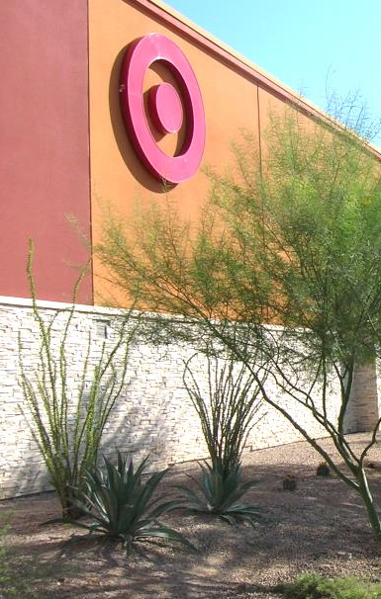
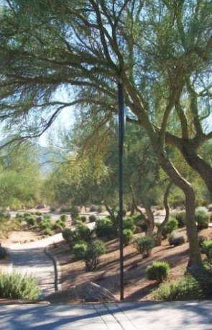
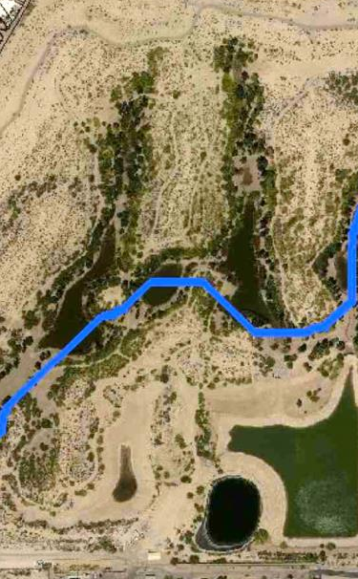
Typical land use sectors with water harvesting potential in the Southwest US
© 2013 ANN AUDREY
© 2013 ANN AUDREY
© 2013 ANN AUDREY
© 2013 ANN AUDREY
© 2013 ANN AUDREY
Single family residential
Multifamily + Subdivision common area
Commercial-scale building
Street
right-of-way
Stormwater management

Slide 11
Targeted land use sector(s)
in (insert YOUR area)
How is your community growing?
Commercial, office, retail, public, industrial and other large building sites
Site have large expanses of roof, parking lot, and other hardscapes from which water can be harvested. Sites are typically graded to eject water rather than harvest it
Existing sites can be difficult to retrofit with water harvesting due to grading
New and substantially rebuilt sites can be designed to convey runoff from multiple hardscapes to landscaped areas and/or direct water to tanks for use outdoors and indoors
Replace pictures and text with land use sector(s) in YOUR area that have water harvesting potential. Duplicate this template slide as needed to insert additional sector slides.
© 2013 ANN AUDREY

Slide 12

Water harvesting benefits, land use sectors and strategies (YOUR area) should focus on
Move circles (from below) over the benefits, water harvesting strategies and land use sectors YOUR community should focus on. Duplicate and change the shape and size of circles, as needed.

Slide 13
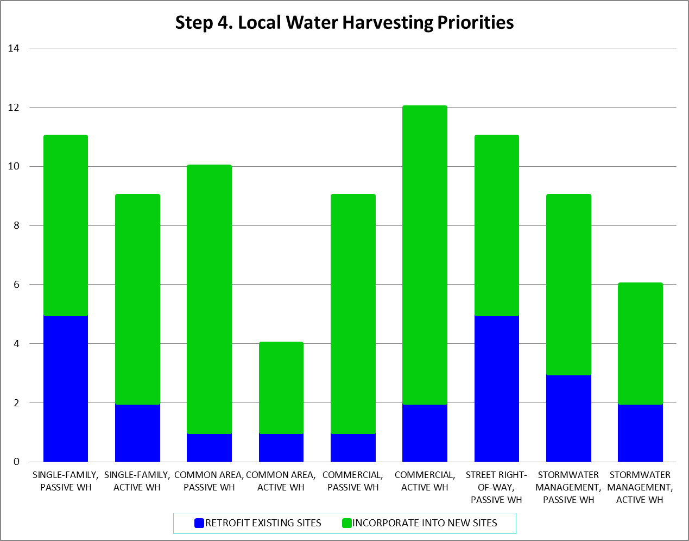
Relative focus on new construction and retrofits based on projected growth in (insert YOUR area)
Replace this chart with the chart generated from YOUR Step 4 discussion, prioritizing water harvesting approaches in YOUR area.

Slide 14
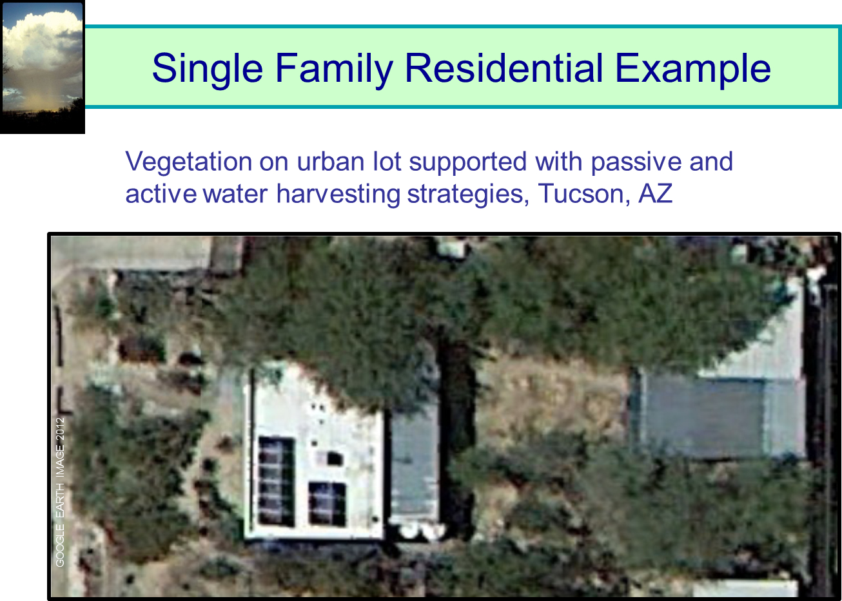
GOOGLE EARTH IMAGE 2012
2008
2012

Slide 15
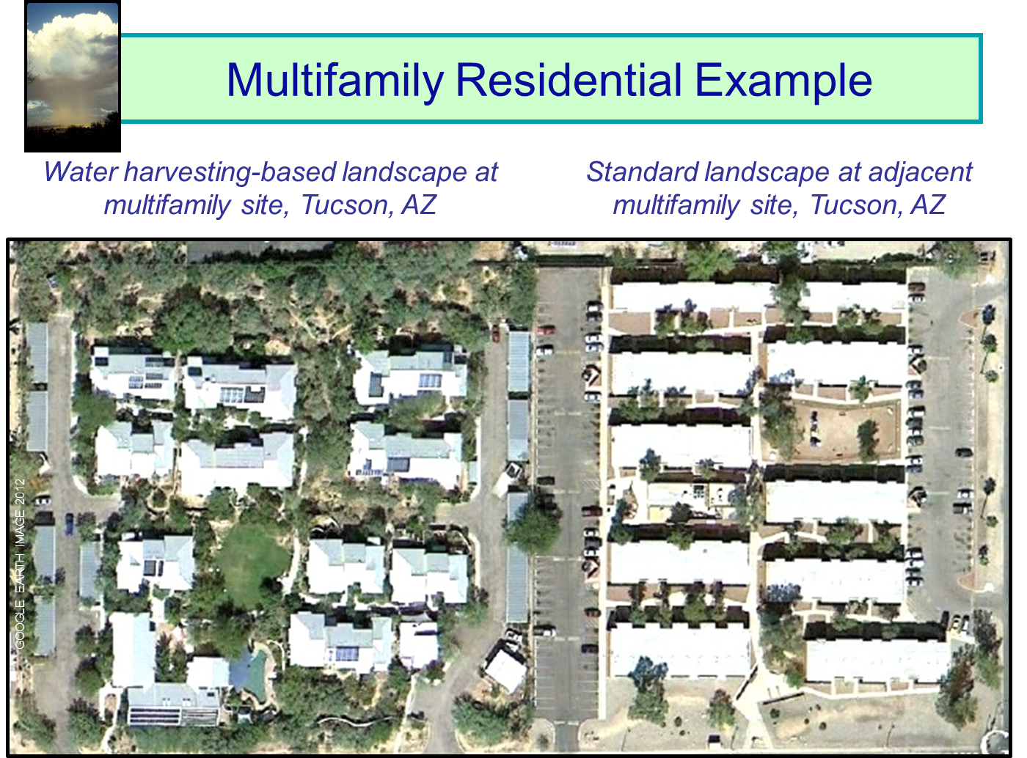
GOOGLE EARTH IMAGE 2012
2008
2012

Slide 16
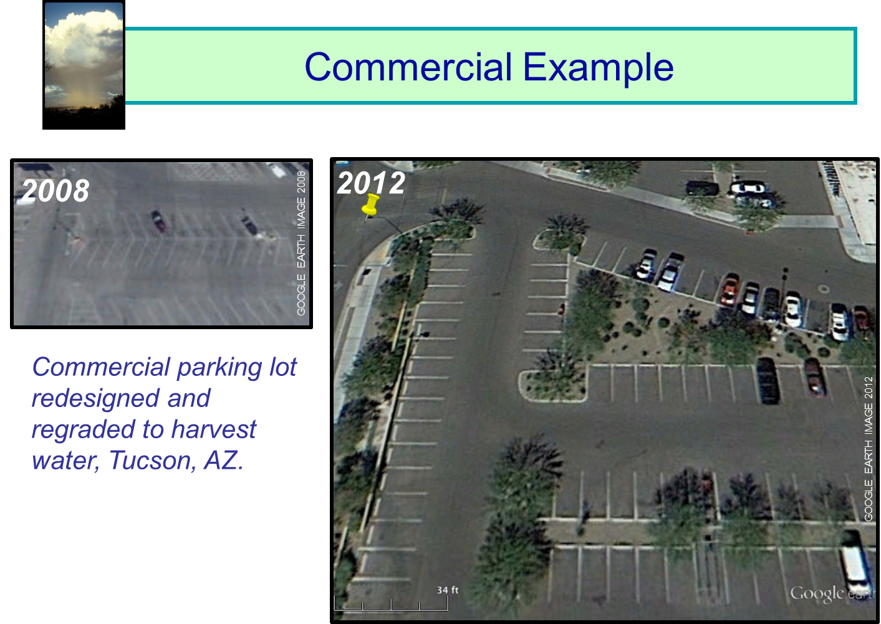
2008
2012
GOOGLE EARTH IMAGE 2008
GOOGLE EARTH IMAGE 2012

Slide 17
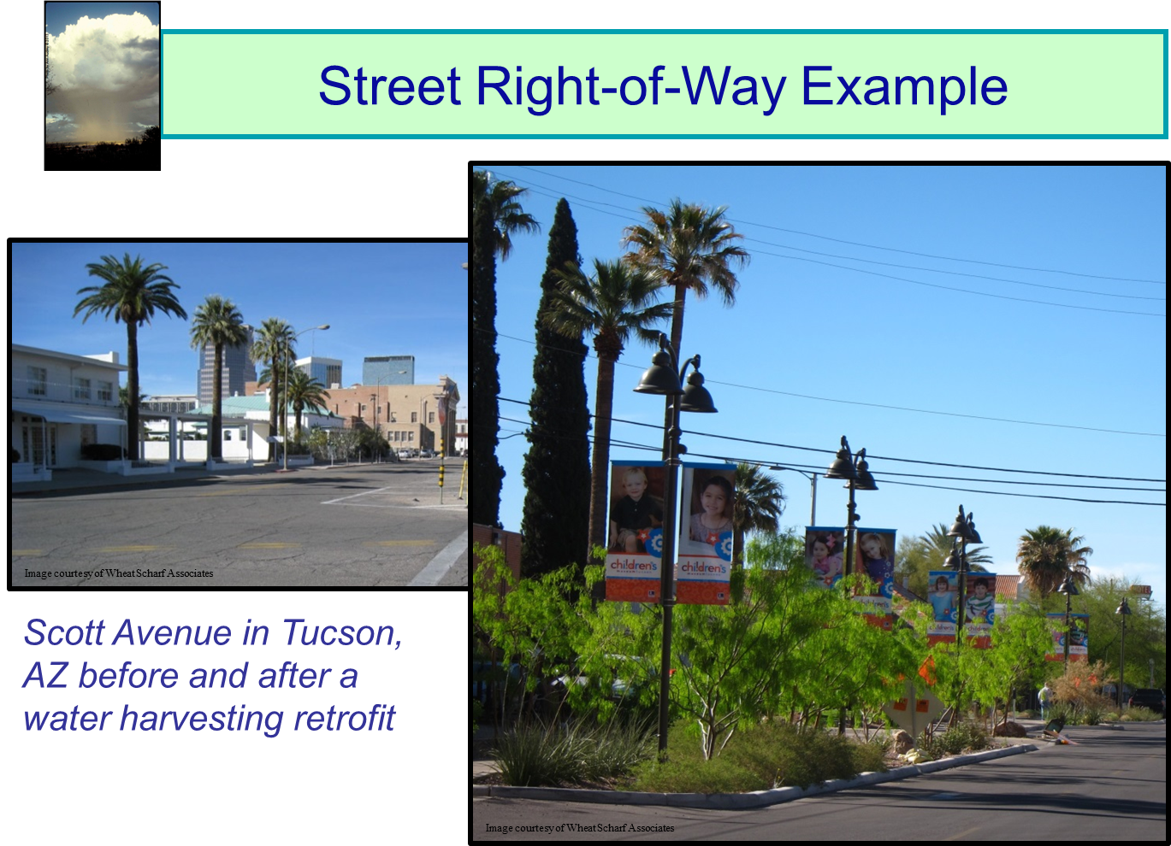
1994
2012

Slide 18
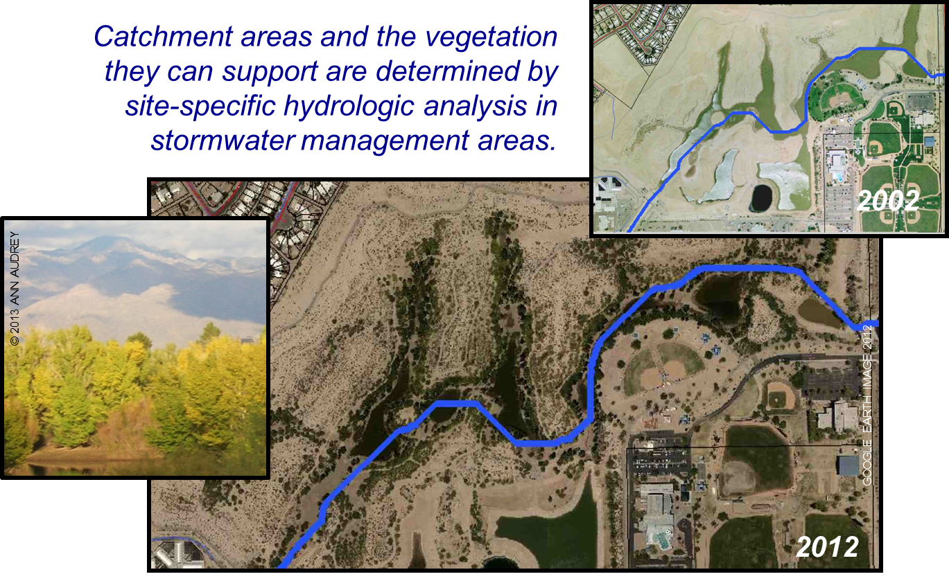
Stormwater management area example
2002
GOOGLE EARTH IMAGE 2012
2012

Slide 19
Typical ways to implement water harvesting in the Southwest US
Remove impediments; develop policy
Provide education and guidance
Refine water harvesting potential data
Demonstrate water harvesting at model sites
Create tangible incentives to harvest water
Use water harvesting as a rezoning condition
Regulate water harvesting
Using multiple implementation approaches increases benefits

Slide 20
(Insert implementation strategy useful for YOUR area)
Year (insert year # for YOUR area)
Direct people to existing water harvesting materials applicable to your area through websites, links, bill inserts, etc.
Determine the value of developing local water harvesting materials such as brochures, guidance documents, and classes; begin such development efforts
Provide recommended low water use plant species lists appropriate for use with water harvesting in your area.
Replace text with descriptions to insert implementation strategies useful in YOUR area. Duplicate this template slide as needed to insert additional implementation strategies.
Year (insert year # for YOUR area)

